Slide 1
How to write a scientific paper?
“Elsevier® journal finder”
www.agrimetsoft.com
https://youtube.com/AgriMetSoft/

Slide 2
What is Elsevier journal finder?
2

Slide 3
3

Slide 4
4

Slide 5
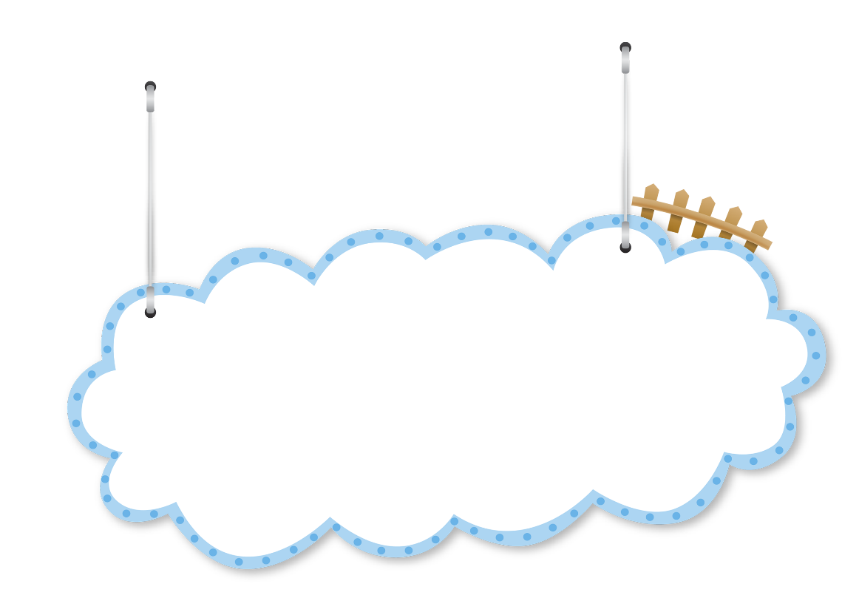
5

Slide 6
Slowing career progress
Missing opportunities
Losing your thesis score
Notes:
With the presence of the Internet, researchers no longer need access to hard copies of their desired journals to keep in touch with the most recent developments. The latest research is disseminated in many ways, including blogs, universities' websites, social media sites, and OA journals that are freely available to anyone with Internet access.

Slide 7
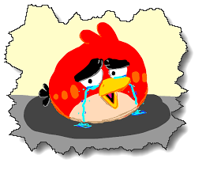
What is Elsevier journal finder?
7

Slide 8
What are the other publishers?
Springer
Watch
the next video
IEEE
Wiley

Slide 9
Please subscribe to our channel (https://youtube.com/AgriMetSoft/)
Like & do not forget to share it!!
Put your comments and questions below the video.
www.agrimetsoft.com
https://youtube.com/AgriMetSoft/
Notes:
Please hit the thumbs up button and don’t forget to subscribe !

